Slide 1

BOBino 1.5 Environmental Logger Kit
Taylor Brockman
2015-Aug-06

Slide 2
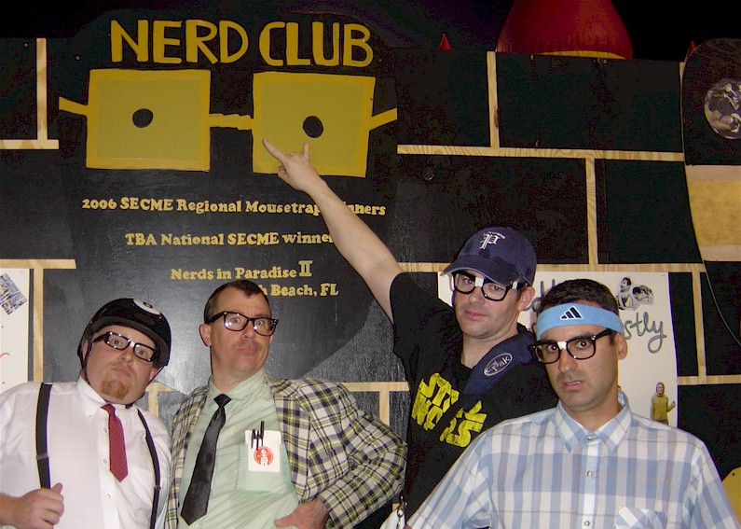
NERD ALERT!

Slide 3

NERD ALERT!
New! Three Temperature Sensors!
Open Source Code and Hardware
Battery Powered, Durable, Cheap

Slide 4

POP that tupperware open!
STICKERS! (w/ QR Code)
Arduino UNO plus “Shield”
SD Memory Card
2 Temperature Sensor Wires
Order Doesn’t Matter
USB Battery and 2 Cables
Power it up! Recharge anytime!

Slide 5

We are LOGGIN The DATA!
Default interval is 15 seconds
Try covering up the Photo Sensor
Try warming up a Temp Sensor
Temp Sensors are submersible
(Bubble Bubble Bubble)

Slide 6

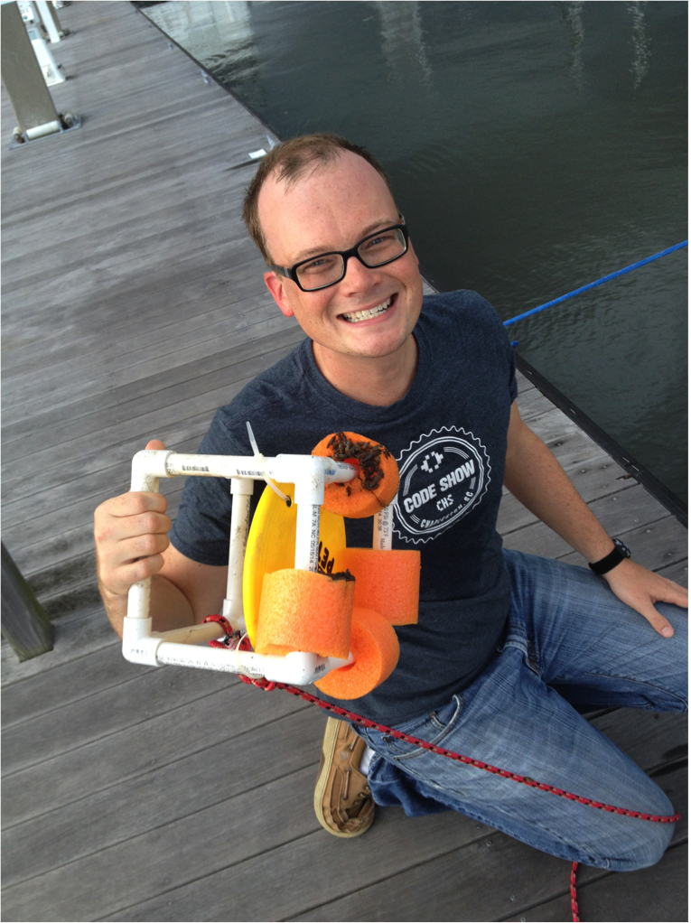
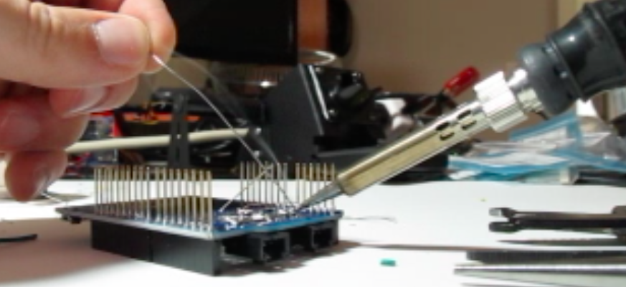
Story Time & Fun pictureS
Marina

Slide 7

Why BOBINO?
Students need exposure to electronic data logging and statistical analysis and visualization.
Commercial alternative is $1500
Cha Ching!

Slide 8

Let’s take a look ON OUR LAPTOPS
SD Card can be plugged into any laptop or PC.
DATA.CSV is “Comma Separated Values” that opens well in Excel.
Change the Log Rate in CONFIG

Slide 9
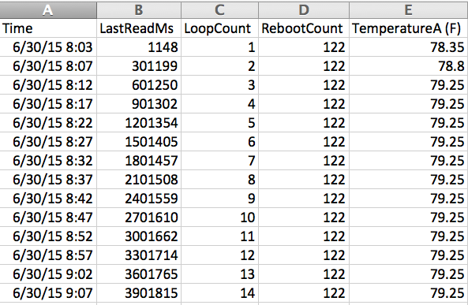
Let’s take a look ON OUR LAPTOPS

Slide 10
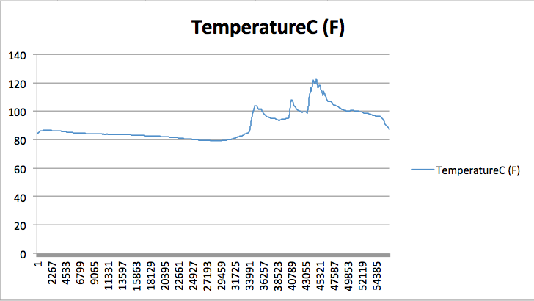
Let’s take a look ON OUR LAPTOPS

Slide 11
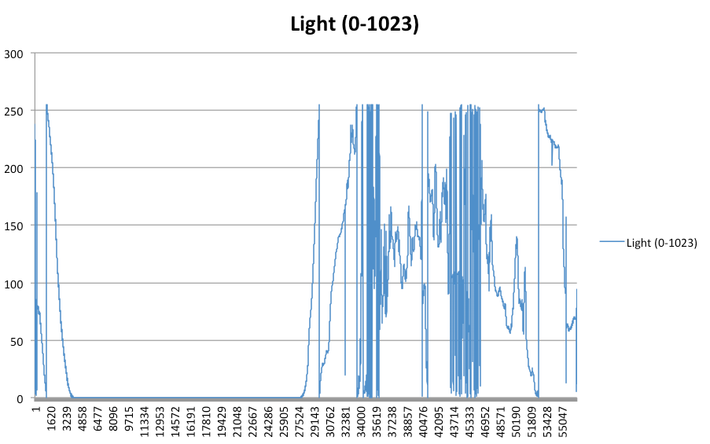
Let’s take a look ON OUR LAPTOPS

Slide 12
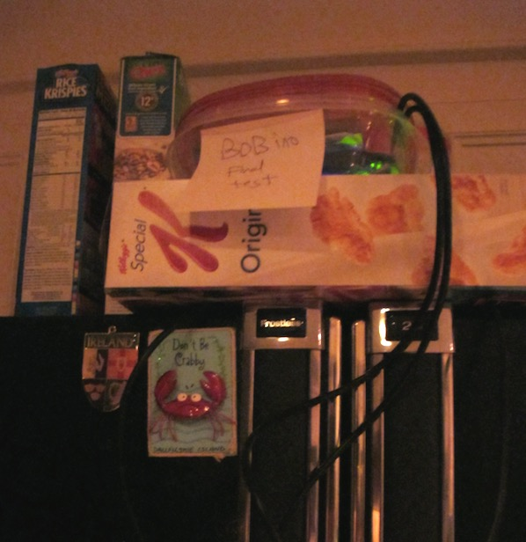
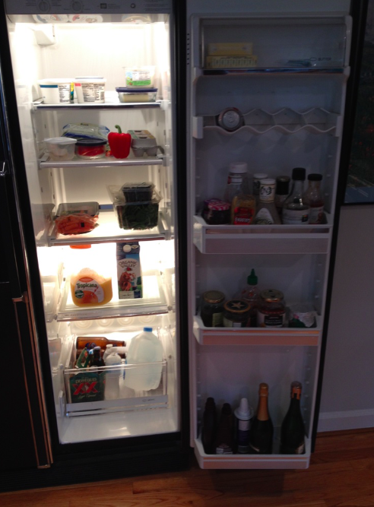
Maybe it’s time to get a new fridge?

Slide 13
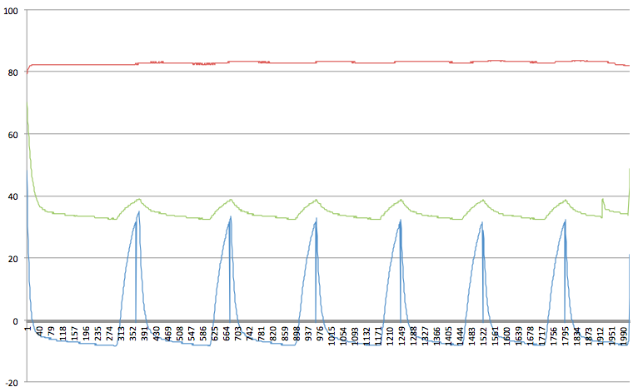
Maybe it’s time to get a new fridge?
Morning Juice!

Slide 14
Experiment IDEAS
Refrigerator Performance
Water Heating via Solar Radiance
Air –vs– Water Temperature Diff
Solar Day Length
Cloud Cover –vs– Temperature
Air Conditioner Thermostat Accuracy

Slide 15

For the Experts
All Source Code is available!
Use the Arduino Programmer, Free Download!
Add More Hardware, Change Shields, Increase the Battery Size
Ocean or Sky is the limit!

Slide 16
BOBino 1.5 Environmental Logger Kit
Taylor Brockman
2015-Aug-06

